Slide 1
UNIT – IV
Risk Assessment and BCP, DR Planning:

Slide 2
Introduction to Risk Analysis
Risk analysis is the process of identifying and analyzing potential issues that could negatively impact key business initiatives or projects. This process is done in order to help organizations avoid
Business continuity planning refers to the process involved in the creation of a system that prevents penitential threats to a company, also aiding in its recovery.
analytical process to provide information regarding undesirable events
process of estimating probabilities and expected consequences for identified risks.
A process undertaken to deal with matters which pose a potential danger, managed according to certain standard procedure and that involves:
– Hazard Identification
– Risk Assessment
– Risk Management
– Risk Communication

Slide 3
Risk Identification
People impact: What are the situations that would impact your employees’ ability to work? Which people or job functions are most critical to your organization’s ability to continue delivering goods and services to customers?
Partner impact: Which partners and service providers are you most reliant on? What is your business impact if a partner’s operations are disrupted?
Facility impact: What are the scenarios that could cause one or more of your worksites to become unavailable? What is your backup plan if a site or region goes offline?
Technology impact: Which systems or tools are used to deliver goods and services to customers? What systems are used to communicate and coordinate internally?
Brand/Reputation impact: What is the financial or brand impact should your business no longer be able to operate normally? What actions should be taken to mitigate lasting damage to customers’ perception of your business?

Slide 4
Risk Assessment
A cybersecurity risk assessment identifies the various information assets that could be affected by a cyber attack (such as hardware, systems, laptops, customer data, and intellectual property), and then identifies the various risks that could affect those assets.
A risk estimation and evaluation is usually performed, followed by the selection of controls to treat the identified risks. It is important to continually monitor and review the risk environment to detect any changes in the context of the organization, and to maintain an overview of the complete risk management process.

Slide 5
Preparing to conduct a risk assessment for your organization, should consider these nine key
Third Party Vendors: How secure are their operations? How much visibility and insight do you have? Who is the cyber security point of contact for each vendor you work with?
Security Management: Who is in charge of implementing strategy? What strategy is being implemented? Has it been effective? What changes should be made?
Security Architecture: What programs are currently in place? How effective are they? What measures can be added? What tools are available to teach employees about the current architecture?
Emerging Technologies: What can be added to enhance security? How secure are new technologies that are currently in place? Where are these technologies applied – physical server, virtual server, cloud?
Regulations and Policy: What is the current security policy? How does it impact overall security? What updates can be made?
Incident and Crisis Management: How are you monitoring for incidents currently? How well is it working? How are incidents resolved today?
Identity Management: What authentications are in place? What password protections are available?
Awareness & Education: What programs are in place to educate employees about cyber security? What tools and guidelines are given to employees?
Threat & Vulnerability Management: What systems are there to identify and remediate vulnerabilities and threat

Slide 6
Risk Response and Mitigation cybersecurity
Identify and document asset vulnerabilities
Identify and document internal and external threats
Assess your vulnerabilities
Identify potential business impacts and likelihoods
Identify and prioritize your risk responses

Slide 7
5 steps to Risk Management:
Step 1: Identify the Risk. You and your team uncover, recognize and describe risks that might affect your project or its outcomes. There are a number of techniques you can use to find project risks. During this step you start to prepare your Project Risk Register.
Step 2: Analyze the risk. Once risks are identified you determine the likelihood and consequence of each risk. You develop an understanding of the nature of the risk and its potential to affect project goals and objectives. This information is also input to your Project Risk Register.
Step 3: Evaluate or Rank the Risk. You evaluate or rank the risk by determining the risk magnitude, which is the combination of likelihood and consequence. You make decisions about whether the risk is acceptable or whether it is serious enough to warrant treatment. These risk rankings are also added to your Project Risk Register.
Step 4: Treat the Risk. This is also referred to as Risk Response Planning. During this step you assess your highest ranked risks and set out a plan to treat or modify these risks to achieve acceptable risk levels. How can you minimize the probability of the negative risks as well as enhancing the opportunities? You create risk mitigation strategies, preventive plans and contingency plans in this step. And you add the risk treatment measures for the highest ranking or most serious risks to your Project Risk Register.
Step 5: Monitor and Review the risk. This is the step where you take your Project Risk Register and use it to monitor, track and review risks.

Slide 8
Risk Reporting
Providing an overview of risk within your digital and vendor ecosystem.
Identifying risks associated with individual vendors enables you to make more informed decisions about vendor selection and vendor relationships.
Showing the impact of programs meant to mitigate and remediate risk.
Demonstrating ROI on investments in cybersecurity and third-party risk management.
Identifying the areas of Critical risk, enabling teams to prioritize remediation efforts.
Identify where your organization falls compared to competitors in terms of cybersecurity program management.

Slide 9
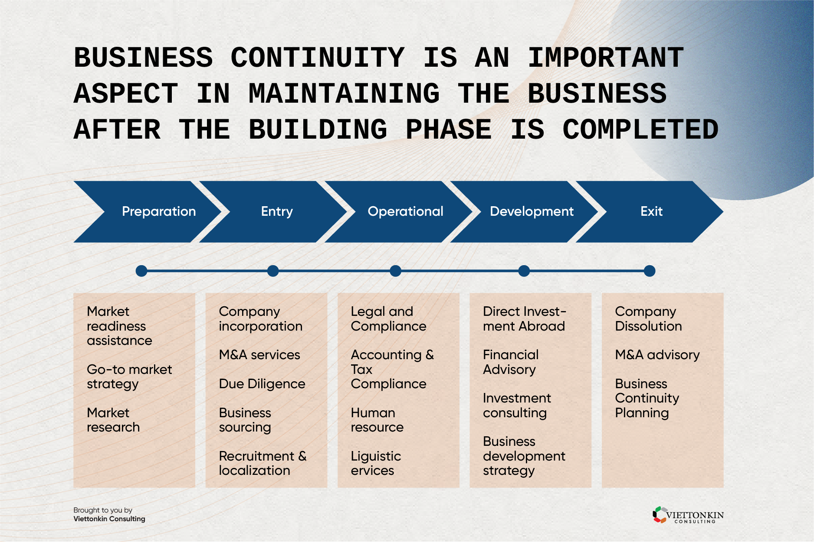
Business Continuity Planning (BCP)
The BCP is creating a plan with related processes and procedures to recover a complete business solution in the case of a disaster.
BCP takes a more complete system and outlines strategies and procedures for all components, such as incident and crisis management

Slide 10
Business Continuity Strategy Design
Continuity and Recovery Strategies and Tactics. Strategy and tactical design activities are taken to address continuity-related risks identified during the analysis phase to facilitate the recovery of a product, service, process, activity, or resource. The GPGs recommend identifying strategies at various levels within an organization in a similar manner to the recommended approach for conducting business impact analyses (BIAs). Strategy identification includes conducting strategic, tactical, and operational level development. These distinctions can be somewhat artificial and the GPGs account for this by dividing up recommended approaches into high-level recovery strategies (designed to continue delivery of products and services) and tactics (designed to recovery resource requirements).
Threat Mitigation Measures. Whereas continuity and recovery strategies are prioritized and designed based on product, service, or process; threat (risk) mitigation targets specific threats or events. The goal of threat mitigation efforts are to identify controls to reduce the likelihood or impact of a specific threat. In some cases, threat mitigation processes may fall out of the direct jurisdiction of business continuity and include mitigation measures requiring the involvement of other subject matter experts.
An Incident Response Structure. Establishing an incident response structure involves chartering the right teams and creating response frameworks to ensure that an organization can respond to and recover from a disruption. PP4 notes the purpose of designing an incident response structure is to “ensure that there is a documented and fully understood mechanism for responding to an incident that has the potential to cause disruption to the organization.” There can be value in setting up response teams at each of the levels in an organization (strategic, tactical, and operational), and PP4 highlights that it will be up to the organization to design a structure and framework that is most relevant.

Slide 11
Disaster recovery plan
The availability of a business process or service depends on technical services, such as a server or database. Therefore, the direct goal of a DRP is to realize the objectives of
Therefore, DRP deals with strategies and procedures for recovering one or more IT solutions a BCP.
While DR focuses on recovering an IT solution from a technical point of view, a BCP takes a more complete system and outlines strategies and procedures for all components, such as incident and crisis management

Slide 12
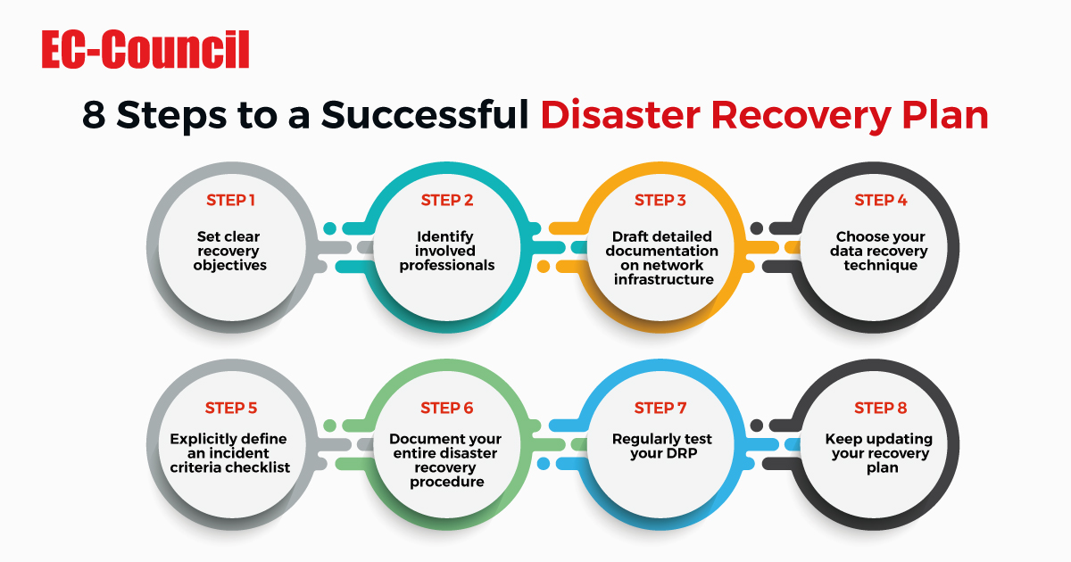
Disaster recovery plan

